Slide 1
Protecting Database Cloud Services with Bastion Service

Slide 2
Business challenge
In the shared responsibility model of PaaS Services like Database Cloud Service, DBCS, or Exadata Cloud Services, ExaCS, the service consumers are granted OS access, and have some responsibilities requiring access to the Linux OS, as user oracle or with group membership equal to the oracle user.
The services is created with the opc account, authenticated with a private/public ssh keypair. User opc is configured to offer sudo root.
From a governance perspective, organizations is required to enforce the usage of named users, and not common accounts Linux like opc or oracle, for the purpose of accountability and auditability
Central governance, with central user CRUD, is the preferred opting, avoiding fragmented user management

Slide 3
Oracle Cloud Infrastructure, Bastion Service
Bastion
Provides restricted and time-limited secure access to resources that don't have public endpoints and require strict resource access controls
With Oracle Cloud Infrastructure (OCI) Bastion service, customers can enable access to private hosts without deploying and maintaining a jump host.
Gaining improved security posture with identity-based permissions and a centralized, audited, and time-bound SSH session
Oracle OCI Bastion Service utilizes Oracle OCI IAM, removing the need for user governance eon Linux host, centralizing all user governance, RBAC access to one single instance of Oracle OCI IAM
References
Oracle OCI Bastion Services
https://docs.oracle.com/en-us/iaas/Content/Bastion/Concepts/bastionoverview.htm
Oracle OCI Identity Domains
https://docs.oracle.com/en-us/iaas/Content/Identity/getstarted/identity-domains.htm

Slide 4
Solution proposal I
Traditional Linux user governance
Deploy user management at Linux level
DBCS and ExaCS runs on Oracle Enterprise Linux, OEL, supporting standard Linux user management/user governance
From a Linux perspective the following will partly support the common requirements:
Don’t share the opc private key, no one is allowed to use ssh with the opc private key.
Each user signing in to the Linux node has their own private key. The oracle account is public and
Shared.
Shared oracle account
Each user signing in to the Linux node has their own private key. The oracle account is public and the users public key are stored in ~/.ssh/authorized_keys
Individual accounts
For each user a personal account is created with the users public key in the users authorized keys file, or the user is authenticated via LDAP over Linux PAM
The users Linux account is assigned to the required groups at Linux level to provide access to the oracle software owner and grid software owner

Slide 5
Solution proposal II
Use Oracle OCI Bastion Service
All access to DBCS or ExaCS Linux vm is tunnelled though the Bastion Services
The Bastion Service resides in a compartment, and only OCI users with access, though OCI policies, to the compartment and the bastion Service will be able to create a bastion ssh session to the linux vm.
The bastion service is configured with a private/public ssh key pair, with the public key in the authorized_keys file of the oracle user. The opc account private key is not used.
The VCN network is configured so the only permittable access over port 22 is from the private endpoint of the bastion host
Oracle net/SQL traffic over port 1521/1522 is permitted from the private subnet
Bastion Service support two types of ssh tunnel:
Managed SSH Session, for compute nodes with the OCI agent running
SSH Port forwarding session, for compute nodes, like DBCS and ExaCS, whithout running OCI agent

Slide 6

Network configuration
Traffic flow
On-Premises
OCI Region
Availability Domain 1
Production Compartment
VCN
Private Subnet
10.0.1.0/24
User
With access to
Linux
Bastion
Dynamic Routing
Bastion private
endpoint
Any permitted endpoint
VPN
Gateway
User
With oracle net/SQL access
22
1521
Private Subnet
10.0.2.0/24
Database
Exadata
Database

Slide 7
Traffic flow
The DBCS or ExaCS instances resided in a separate subnet, 10.0.2.0/24, and Network Security Groups, NSG, is configured for permitting ingress/egress traffic.
With a NSG, the only permitted traffic over port 22 to the DBCS instance or ExaCS instance s from the private endpoint of the Bastion Service, resides in the 10.0.1.0/24 subnet
Oracle Net traffic is configured based on the application and oracle net/SQL traffic requirements, in the example, only from the 10.0.1.0/24 subnet

Slide 8
Bastion Configuration and usage
Bastion Service is a two step process
Create the Bastion Service, which created the private endpoint in the subnet
Create a private ssh key pair pr. user that needs access. Upload the public key to ~/.ssh/authorized_keys in the oracle account on the DBCS or ExaCS server
For each time access is needed, create a Bastion Session. The Bastion Session is valid for 3 hours, The bastion session generates a new ssh private/public key pair, used for ssh connection to the Bastion Service
The private key for authentication of the oracle Linux account is tunnelled through the Bastion Session

Slide 9
Bastion Service Creation

Slide 10
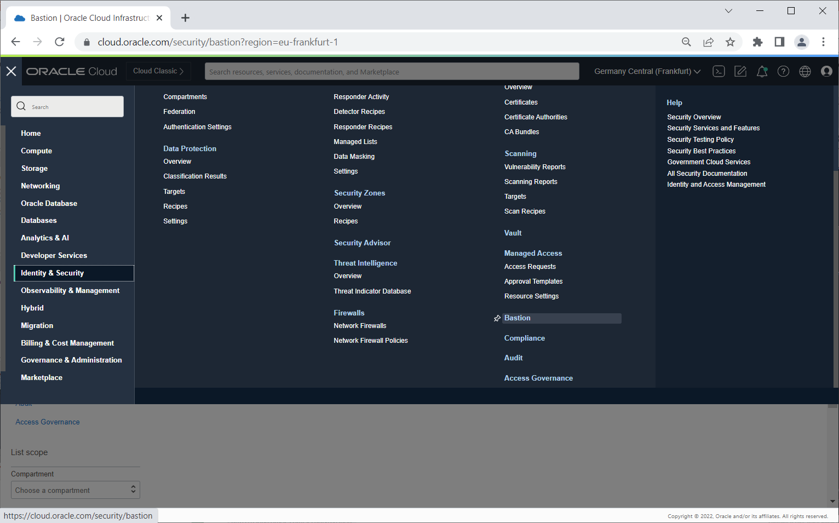

Slide 11
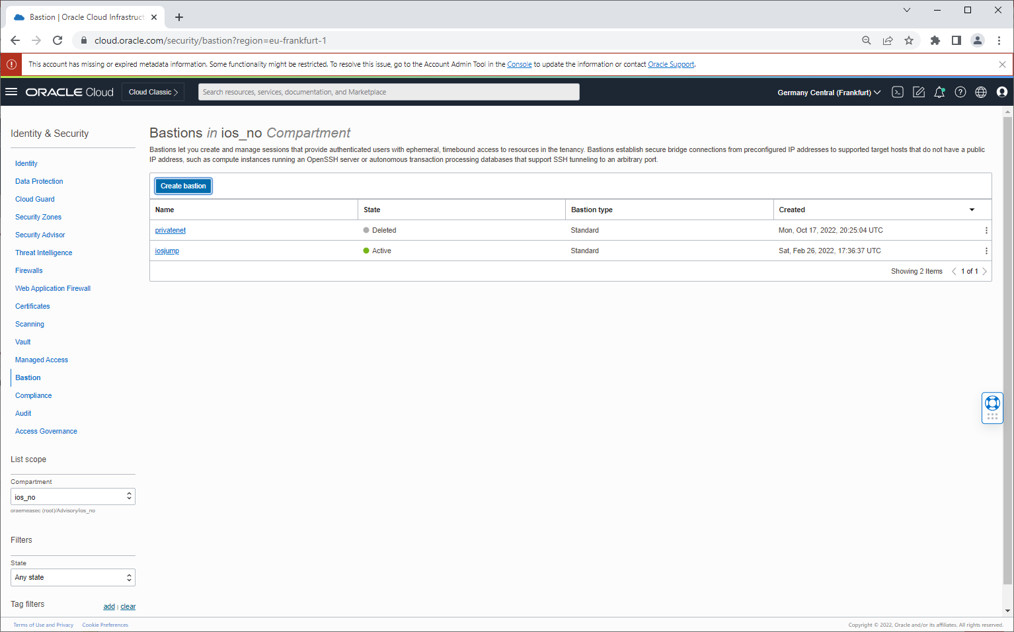

Slide 12
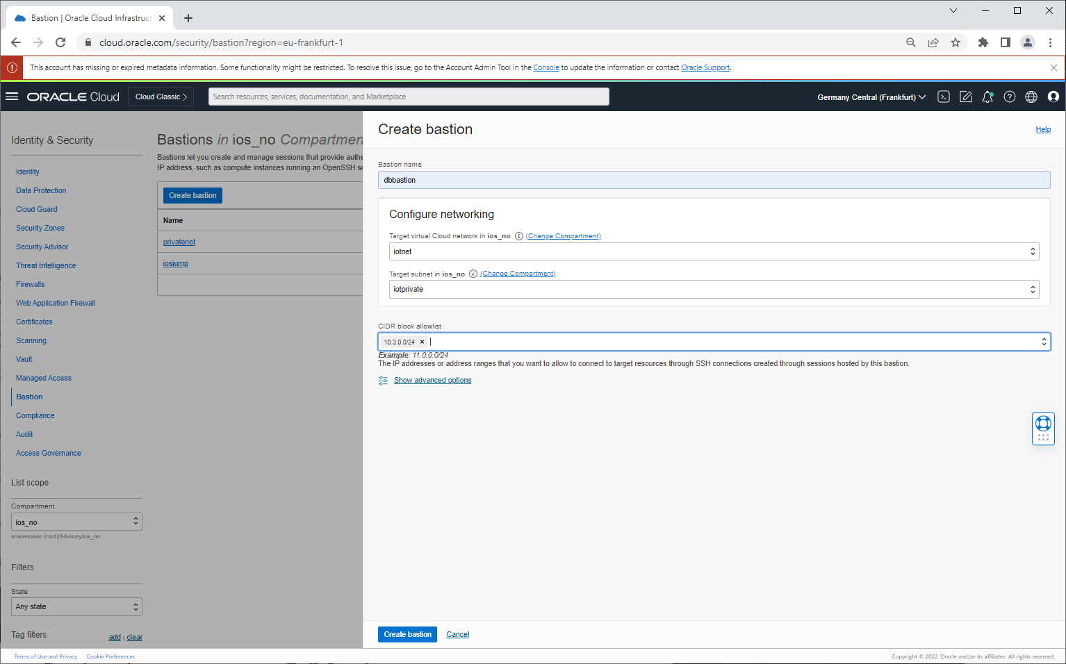

Slide 13


Slide 14
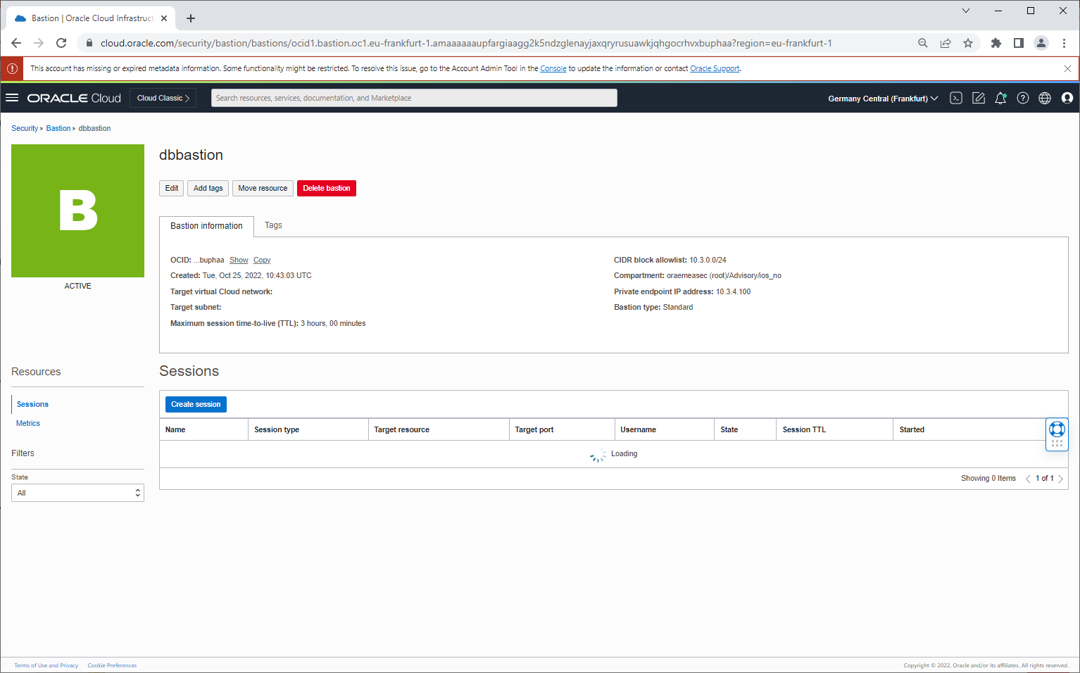

Slide 15
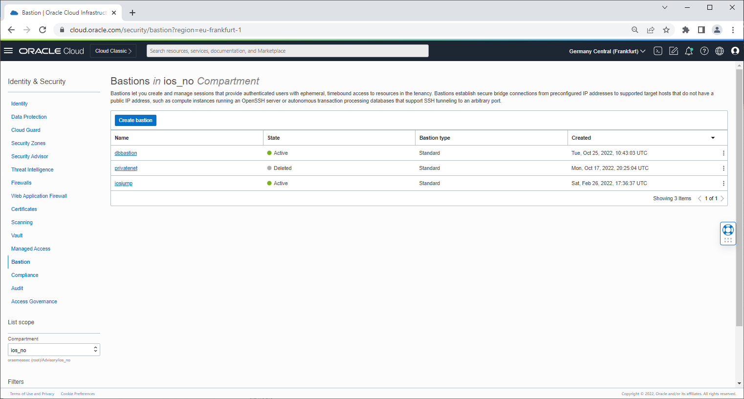

Slide 16
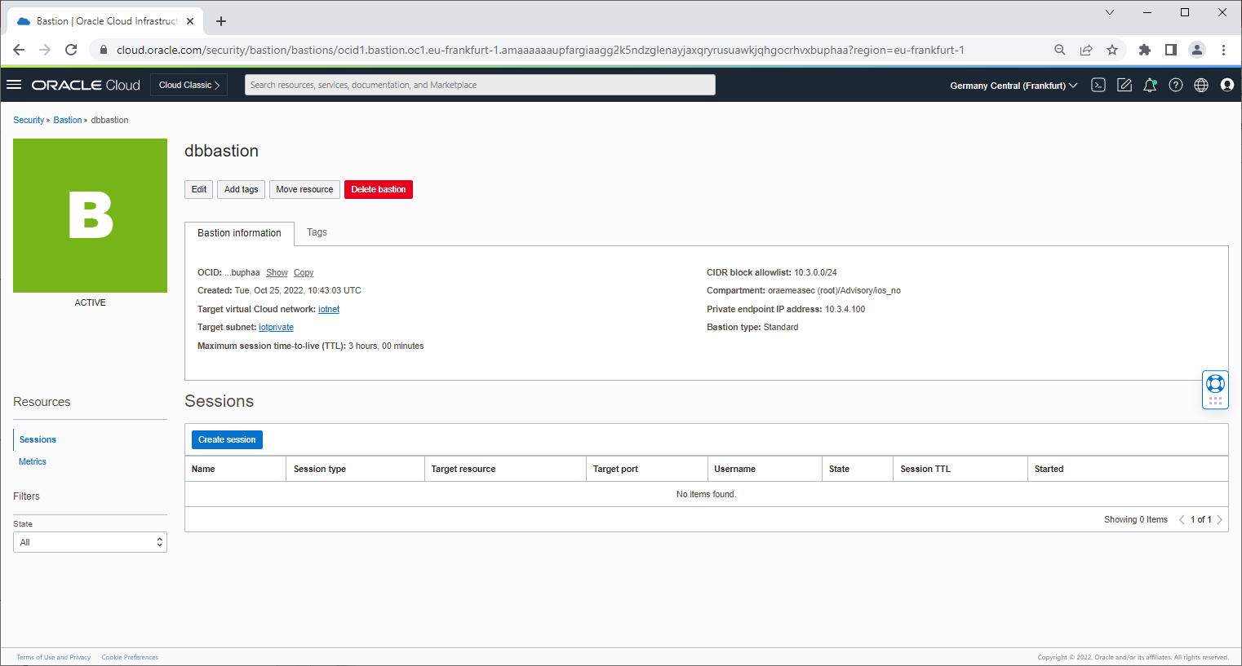

Slide 17
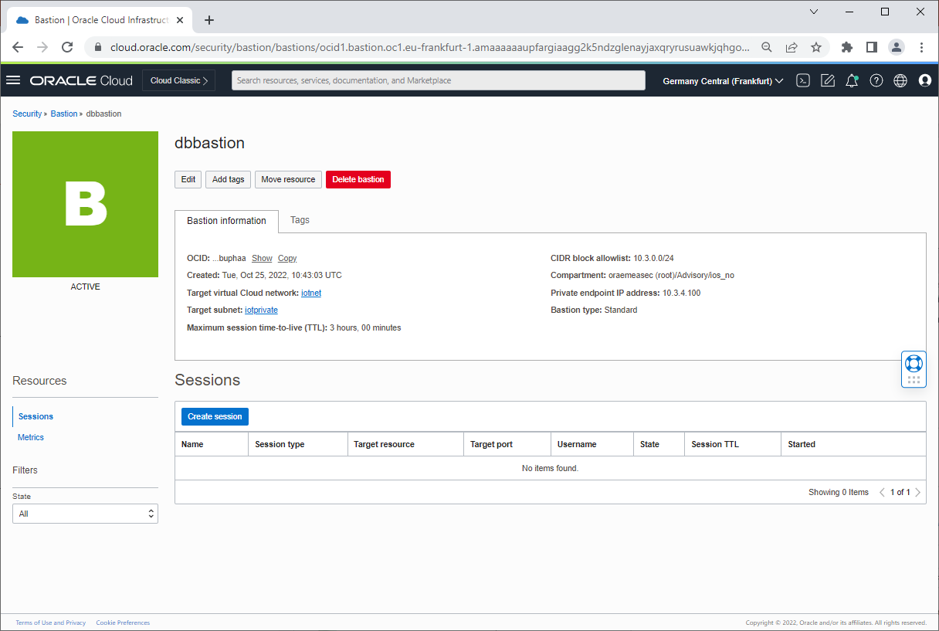
The Network Security Group, NSG reflects the private endpoint of the Basion Service

Slide 18
Bastion Session Creation

Slide 19
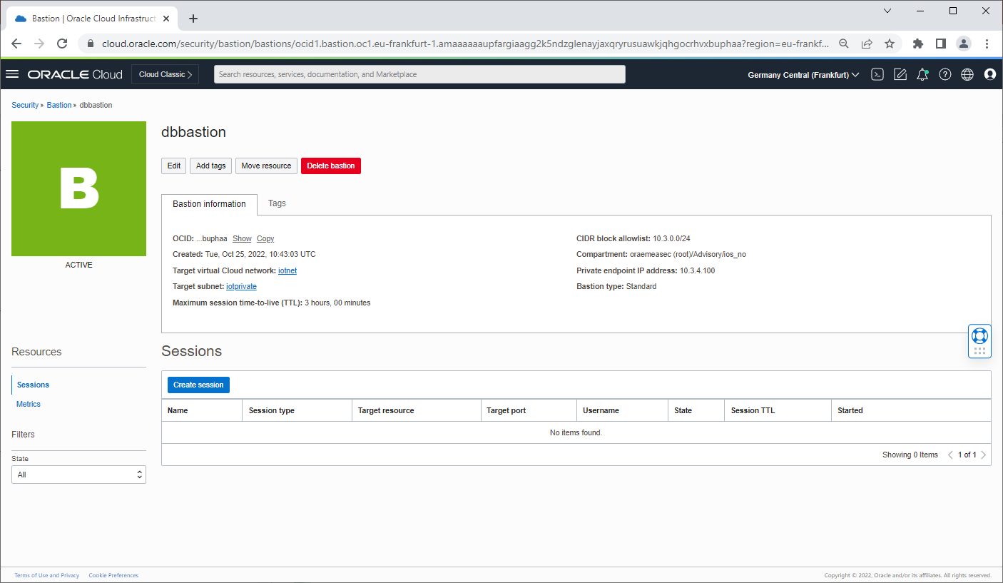

Slide 20
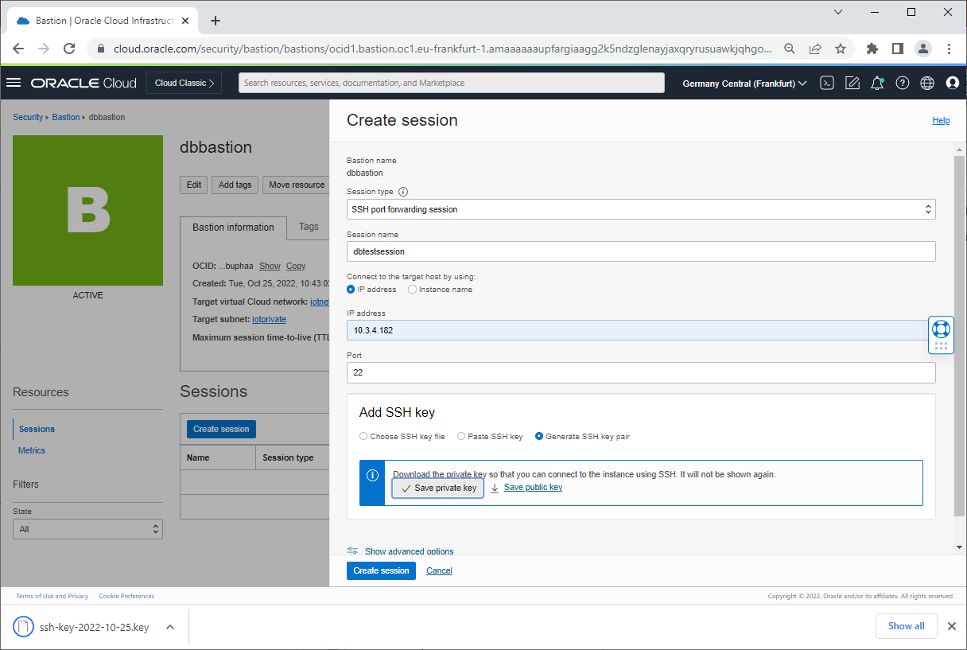

Slide 21
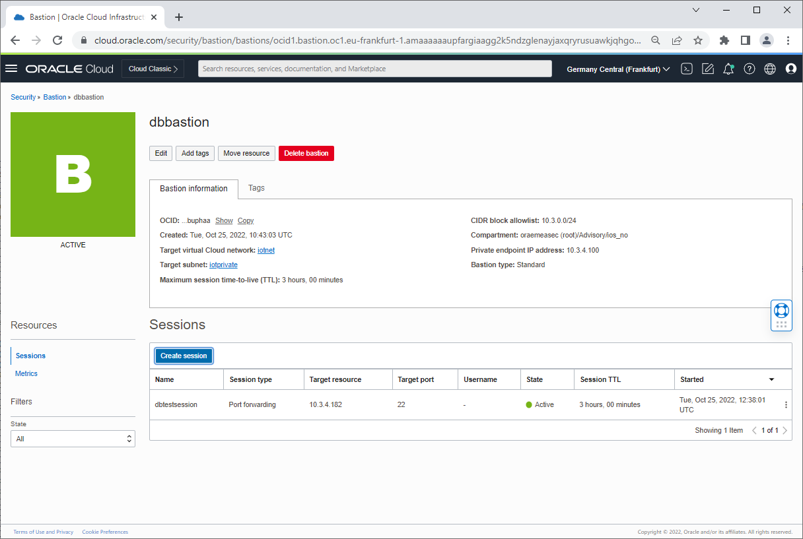

Slide 22
ssh access to target resource via ssh tunnel

Slide 23
Bastion Session Creation
Start the ssh-agent
eval `ssh-agent`
Upload the users own private key
ssh-add myprivatekey.key
Upload the private key created by the bastion session
ssh-add bastion-session.key
Create a resident ssh tunnel to the target, through the Bastion Service
ssh -N -4 -L 8222:10.3.4.182:22 -p 22 ocid1.bastionsession.oc1.eu-frankfurt-1.a*****@host.bastion.eu-frankfurt-1.oci.oraclecloud.com
Connect to the target over the ssh tunnel

Slide 24
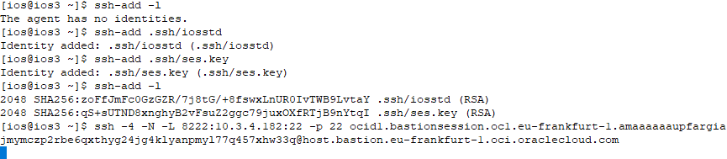
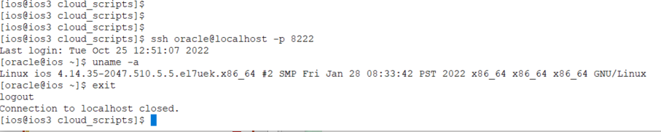
ssh tunnel example

Slide 25
Example script for creating bastion service session, Managed SSH Session with OCI CLI

Slide 26
#!/bin/bash
#
# Example script that creates a managed ssh session with the bastion service
#
PYENV=/home/ios/py38
OCIPROFILE=oraemeasec
BASTIONOSID="ocid1.bastion.oc1.eu-frankfurt-1.amaaaaaaupfargial6ibktqk7xmz6kywqkcwsxrmqrdqjsyyf24qvwcqnbpq"
SSHKEYDIR="/home/ios/.ssh/"
SSHPUBFILE="bastion_pub"
SSHPRIVATEFILE="bastion.pem"
DISPLAYNAME="iosjumpv3-session"
RESOURCEID="ocid1.instance.oc1.eu-frankfurt-1.antheljsupfargic47fjgar7f34zdiccsv5wmrfsv4bnkfnyindlh6ew46ka"
OSUSERNAME=opc
RESOURCEPORT=22
RESOURCEIPADDRESS="10.3.4.86"
OCIREGION="eu-frankfurt-1"
TIMETOLIVE=1800
TEMPFILE=/home/ios/tempCreateSession.json
#
# Activate python env for OCI config
#
source py38env/bin/activate

Slide 27
#
# build inputfile for session creation
#
echo '{
"bastionId": "'${BASTIONOSID}'",
"displayName": "'${DISPLAYNAME}'",
"keyType": "PUB",
"maxWaitSeconds": 0,
"sessionTtl": "string",
"session-ttl-in-seconds": '${TIMETOLIVE}',
"sshPublicKeyFile": "'${SSHKEYDIR}${SSHPUBFILE}'",
"target-resource-details": {
"session-type": "MANAGED_SSH",
"target-resource-id": "'${RESOURCEID}'",
"target-resource-operating-system-user-name": "'${OSUSERNAME}'",
"target-resource-port": '${RESOURCEPORT}',
"target-resource-private-ip-address": "'${RESOURCEIPADDRESS}'"
},
"waitForState": [
"SUCCEEDED"
],
"waitIntervalSeconds": 60
}' >$TEMPFILE

Slide 28
#
# Create the session
#
#CSTATUS=`oci bastion session create --profile $OCIPROFILE --bastion-id --from-json "file://${TEMPFILE}"`
CSTATUS=`oci bastion session create --profile $OCIPROFILE --from-json "file://${TEMPFILE}"`
echo $CSTATUS | jq '.data."lifecycle-state"' | grep \ 'ACCEPTED\|CANCELED\|CANCELING\|IN_PROGRESS\|SUCCEEDED\|ACTIVE\|CREATING'
if [ $? -ne 0 ]
then
echo $CSTATUS
echo ""
echo "Creation of session failed"
exit 1
fi
#
# check if creation failed
#
ASTATUS=`echo $CSTATUS | jq '.data."lifecycle-state"' | sed 's/"//g'`
if [ "$ASTATUS" = "FAILED" ]
then
echo $CSTATUS
echo "Creation of session failed"
exit 2
fi

Slide 29
#
# grab the ID of the session, and check if it is active
#
ID=`echo $CSTATUS | jq '.data.id' | sed 's/"//g'`
echo "ID: "$ID
if [ "$ASTATUS" != "ACTIVE" ]
then
echo "waiting for session creation (approx 60 sec.)"
for I in 1 2 3 4 5 6
do
sleep 10
ASTATUS=`oci --profile $OCIPROFILE bastion session get --session-id $ID | jq '.data."lifecycle-state"' | sed 's/"//g' `
if [ "$ASTATUS" = "ACTIVE" ]
then
echo "bastion service is ready"
break
fi
echo "Creation status: "${ASTATUS}
done
if [ "$ASTATUS" != "ACTIVE" ]
then
echo "bastion service is not yet available "
echo "Please verify with command: "
echo "oci --profile $OCIPROFILE bastion session get --session-id $ID"
exit 1
fi
fi

Slide 30
#
# Connect to the session
#
ssh -i ${SSHKEYDIR}${SSHPRIVATEFILE} -o ProxyCommand="ssh -i ${SSHKEYDIR}${SSHPRIVATEFILE} -W %h:%p -p 22 ${ID}@host.bastion.${OCIREGION}.oci.oraclecloud.com" \
-p ${RESOURCEPORT} ${OSUSERNAME}@${RESOURCEIPADDRESS}

